Slide 1
MAVEN TOYS SALES ANALYSIS

Slide 2
Data Overview
The data includes Sales data from “Maven Toys” store in Mexico
Composed from 4 tables: Sales, Products, Stores and inventory
Historical sales transactions starting from January 2017 to September 2018
Additional information:
Sales data consists of more than 820k transactions
50 different stores across 29 cities and 4 locations (Downtown, Commercial, Airport, Residential)
Prices and costs for all the products and their associated categories - Toys, Electronics, Art & Crafts, Sports & Outdoors and Games (Price and costs are fixed in both years)
Amount of units in stock for each product in each store (For the time being)

Slide 3
Analysis Goal:
Analysing and Identifying sales trends in order to maximize Maven Toys’ overall profit with a specific focus on Electronics and Art & Crafts categories.
Research Questions:
What is the company’s overall profit comparing to last year?
What is the sales performance between categories?
What is the gross profit and profit margin for each category?
What are the most profitable products in each category?
Identifying sales trends for the different products within their category

Slide 4
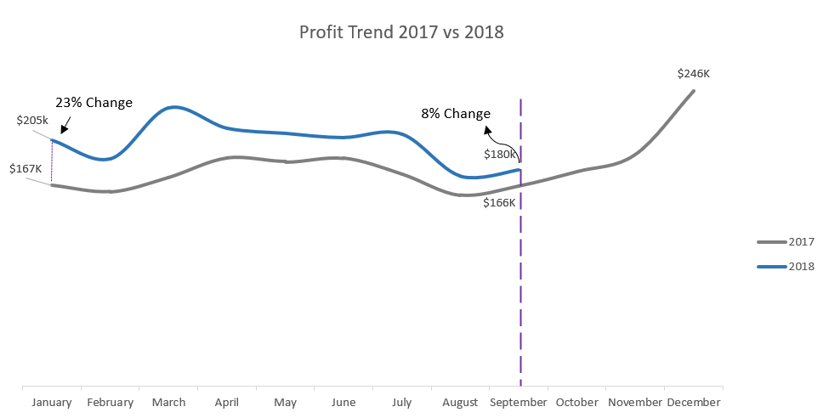
As for September 2018, our profit is only 8% higher than September last year, while starting at 23%. Comparing to this point of time last year (2017), Maven Toy’s overall profit has increased by 16%.
Profit Trend 2017 vs. 2018
Notes:
לשנות את כיוון החץ מכיוון ה-8% לכיוון המרווח (כמו בינואר 17) להשאיר רק את המספר בהתחלה והסוף.

Slide 5
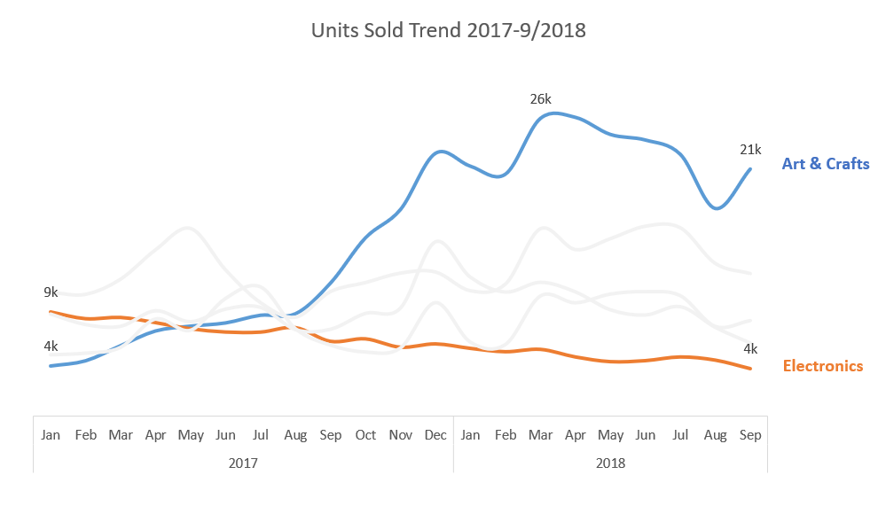
Art & Crafts experienced 395% increase in units sold since January 2017, while Electronics is continuously declining - resulting in 54% decrease in units sold
Units Sold per Category
Notes:
להוריד את ה26
כותרת לגרף: Units Sold per Category

Slide 6
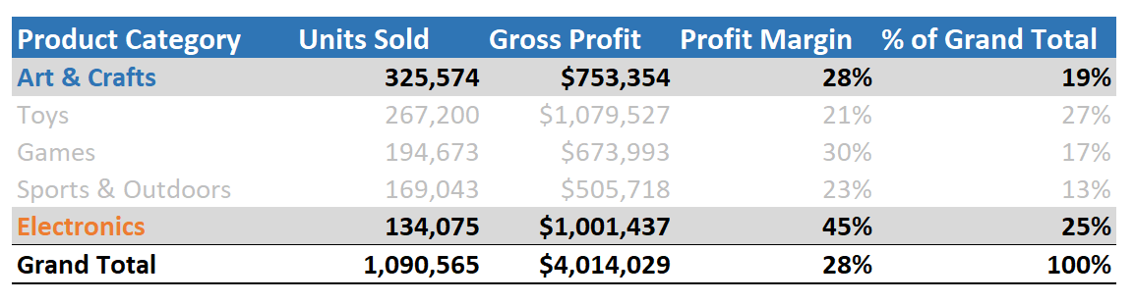
Despite selling only12% from total units sold, Electronics hold the highest profit margin with 45% (25% of Maven Toys’ Total profits).
Art & Crafts consists 30% from total units sold with 28% profit margin (19% of Maven Toys’ Total profits).

Slide 7
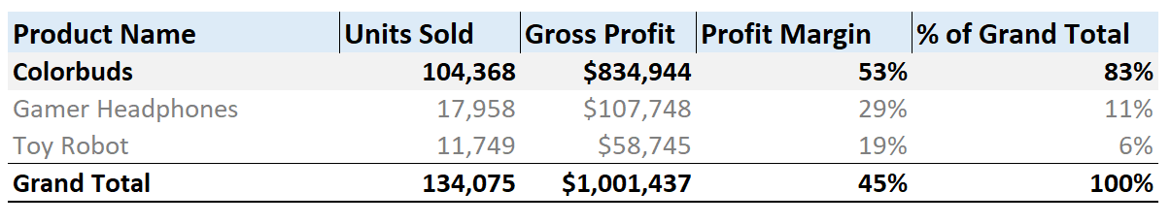
Colorbuds is the most selling product in Electronics, consisting 83% of the total profit, with 53% profit margin.

Slide 8

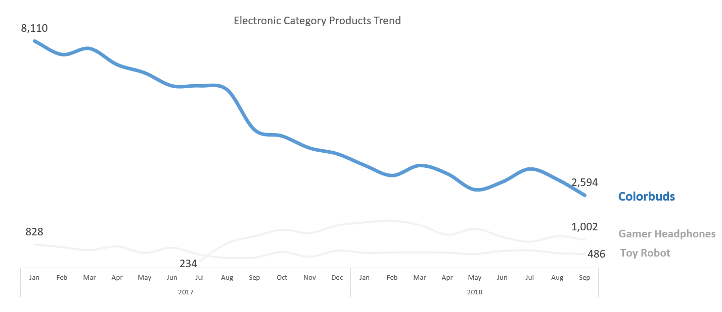
From Jan-2017 to Sep-2018, Colorbuds sales and profits have decreased by 68%, respectively.
Electronics Product Sales Trend
Action Item:
We should consider replacing the colorbuds product line with an alternative and more innovative product, while maintaining the same profit margin.
Notes:
Electronic’s product sales trend
להוריד את המספרים משני המוצרים הנוספים לשנות את הצבע לכתום

Slide 9
Average monthly sales is exceeding the amount of units in stock; We predict to sell all inventory by the end of October 2018. (In the last 3 months – Average units sold is 3,099, 27% decrease in sales)
Action Item:
If not sold by the end of October 2018, consider promotion days and discounts, to sell all Colorbuds’ inventory.
*2017 sales were excluded

Slide 10
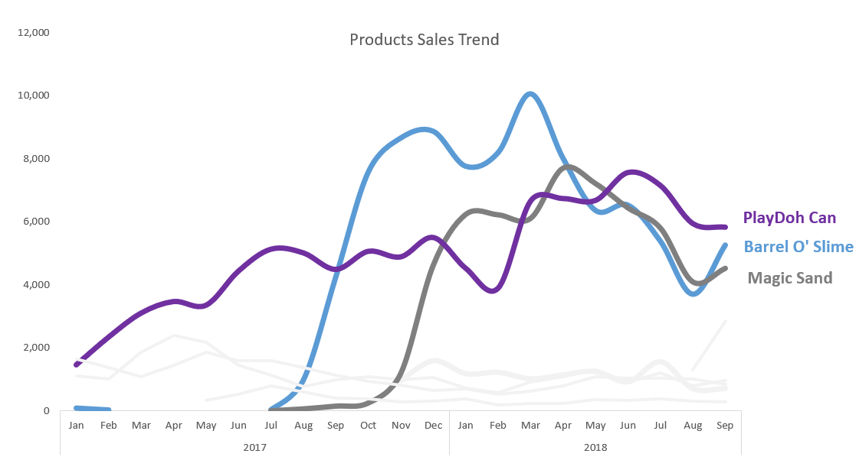
Despite major growth coming from Barrel O’ Slime and Magic Sand, a steep decline in sales starting on Q2-2018 PlayDoh Can seems to be our best seller product, maintaining consistent growth in sales
Action Item:
Monitor sales Performance of Barrel O’ Slime and Magic Sand and consider replacing it with new trendy products.
Review a price change for PlayDoh Can and its affect on profit after conducting an A/B test in stores

Slide 11
Main Findings
Electronics:
Electronics is responsible for 25% from our overall profit while selling the least amounts of units.
Colorbuds is the most profitable product in the category - responsible for 83% of its category total profit.
Entering into October 2018, our Colorbuds’ stock is lower than its average units sold
Art & Crafts:
77% of total sales composed from Barrel O’ Slime(25%), Magic Sand(20%) and PlayDoh Can(32%)
Sales growth was affected by the entrance of Barrel O’ Slime and Magic Sand to the category
Barrel O’ Slime and Magic Sand’s sales have decreased in previous months by 48% and 41% respectively
PlayDoh Can - best seller in terms of sales growth consistency, holds the highest amount of sales (as for Sep-2018)
Notes:
Electronics:
the second most profitable category, In a continuous decline since January 2017.
decreased by 68% in 21 months

Slide 12
Recommendations
Electronics:
We recommend searching for an alternative product line to replace Colorbuds. Consider new product line to maintain at least 30% profit margin (either by raising the product price or lowering the product cost)
If not sold by the end of October 2018, consider promotion days and discounts, to sell all Colorbus’ inventory
Art & Crafts:
Monitor sales Performance of Barrel O’ Slime and Magic Sand. Consider replacing it with new trendy products. (In case of sales growth, re-negotiate with suppliers to decrease costs)
Conduct an A/B test in stores while increasing PlayDoh Can’s price by 1$ (33%) for one month. Monitor sales performance and consider a price increase at all stores to increase profitability

Slide 13
Thank you for
listening!

